Slide 1
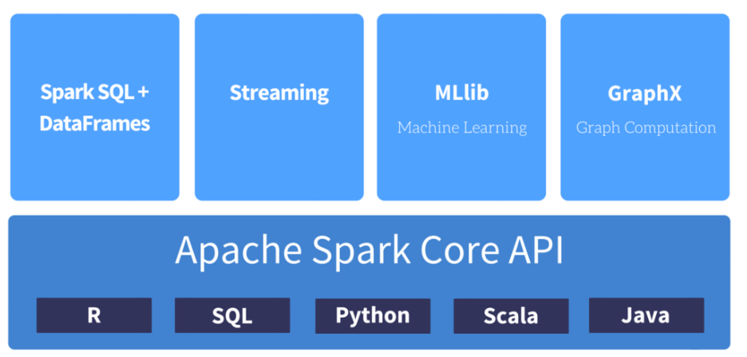
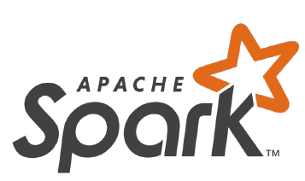
Apache Spark Overview
Apache Spark:
is a fast and general purpose big data processing engine.
is an open source project incubated by Apache Software Foundation
https://spark.apache.org/
https://github.com/apache/spark
is an unified engine with built-in modules for SQL, streaming, machine learning, graph processing & third-party packages.
Figure Ref: http://syntelli.com/data-capability/apache-spark/

Slide 2
Conceptual Introduction to Spark Application

Slide 3
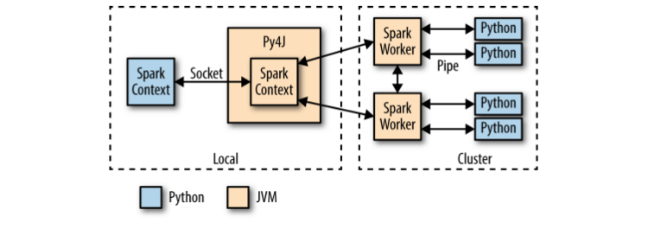
About Pyspark (Python API for Spark)
Spark is internally developed in Scala. Scala Apps run on JVM (Java Virtual Machine) Threads similar to Java. List of JVM Languages
IMPORTANT: Pyspark API Documentation: https://spark.apache.org/docs/latest/api/python/index.htmln
Notes:
Overview of PySpark Python is a favorite tool for many data scientists, due to its high-level syntax and extensive library of packages, among other things. The Spark ecosystem has recog‐ nized Python’s importance in the data analytics milieu, and has begun to invest in a Python API for using Spark, despite Python’s historical difficulties integrating with the JVM.
Note: Java Virtual Machine (JVM), is a system process used to run JVM based applications (written in Scala, Java, Groovy) that executes anything developed in Java & Scala languages. Since spark is developed in Scala, it needs a JVM process. It provides wrapper functions to enable in Python and R development.
Start PySpark just like Spark:
export IPYTHON=1 # PySpark can use the IPython shell pyspark --master ... --num-executors ...
pyspark takes the same Spark arguments as spark-submit and spark-shell
We can submit Python scripts using spark-submit , which will detect the .py exten‐ sion on our scripts. PySpark supports the use of the IPython shell by setting the envi‐ ronment variable IPYTHON=1 , which is something we recommend universally. When the Python shell starts, it creates a Python SparkContext object through which we interact with the cluster. Once the SparkContext is available, the PySpark API is very similar to the Scala API.
For example, to load some CSV data:
Just like in the Scala API, we load a text file, filter out rows that start with # , and parse the CSV data into a list of float values. The Python functions passed to, for example, filter and map , are very flexible. They must take a Python object and return a Python object (in the case of filter , the return value is interpreted as a boolean). The only restrictions are that the Python function objects must be serializable with cloudpickle (which includes anonymous lambda functions), and any necessary modules referenced in the closures must be available on the PYTHONPATH of the execu‐ tor Python processes. To ensure the availability of referenced modules, either the modules must be installed cluster-wide and available on the PYTHONPATH of the execu‐ tor Python processes, or the corresponding module ZIP/EGG files must be explicitly distributed around by Spark, which will then add them to the PYTHONPATH . This latter functionality can be accomplished by a call to sc.addPyFile() .
The PySpark RDDs are just RDDs of Python objects: like Python lists, they can store objects with mixed types (because underneath, all the objects are instances of PyObject ).
The PySpark API (Application Programming Interface) can lag behind the Scala API to a certain extent, so in some cases, features become available in Scala more rapidly. However, in addition to the core API, there already exists a Python API to MLlib, for example, which is used in Thunder.
PySpark Internals It is useful to understand a bit about how PySpark is implemented in order to sim‐ plify debugging and also to be conscious of possible performance pitfalls
When PySpark’s Python interpreter starts, it also starts a JVM with which it commu‐ nicates through a socket (networking socket!!!). PySpark uses the Py4J project to handle this communica‐ tion. The JVM functions as the actual Spark driver, and loads a JavaSparkContext that communicates with the Spark executors across the cluster. Python API calls to the SparkContext object are then translated into Java API calls to the JavaSparkCon text . For example, the implementation of PySpark’s sc.textFile() dispatches a call to the .textFile method of the JavaSparkContext , which ultimately communicates with the Spark executor JVMs to load the text data from HDFS.
The Spark executors on the cluster start a Python interpreter for each core, with which they communicate data through a pipe when they need to execute user code. A Python RDD in the local PySpark client corresponds to a PythonRDD object in the local JVM. The data associated with the RDD actually lives in the Spark JVMs as Java objects. For example, running sc.textFile() in the Python interpreter will call the JavaSparkContext s textFile method, which loads the data as Java String objects in the cluster. Similarly, loading a Parquet/Avro file using newAPIHadoopFile will load the objects as Java Avro objects.
When an API call is made on the Python RDD, any associated code (e.g., Python lambda function) is serialized via cloudpickle and distributed to the executors. The data is then converted from Java objects to a Python-compatible representation (e.g., pickle objects) and streamed to executor-associated Python interpreters through a pipe. Any necessary Python processing is executed in the interpreter, and the result‐ ing data is stored back as an RDD (as pickle objects by default) in the JVMs.
Python’s built-in support for serializing executable code is not as powerful as Scala’s. As a result, the authors of PySpark had to use a custom module called “cloudpickle” built by the now defunct PiCloud.
Jupyter Notebook
Jupyter Notebook is a fantastic environment for exploratory analytics and for use as a computational “lab notebook.” It allows the user to integrate text, images, and exe‐ cutable code (in Python and now other languages), and also supports a hosted plat‐ form, among other features. While Jupyter Notebook works well with Spark, it requires some care to configure correctly because PySpark must be initialized in a particular way. --> and I shared how you are going to do Pyspark setup in the end of Session 1.

Slide 4
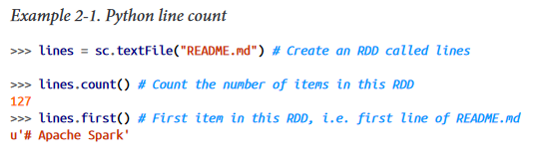
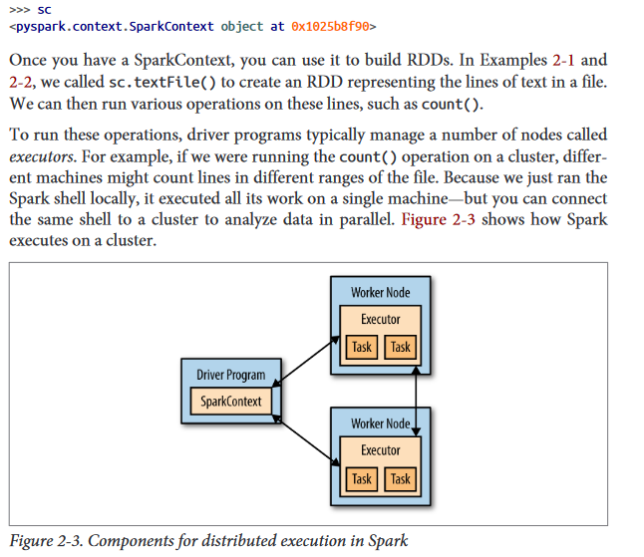
Book
http://index-of.co.uk/Big-Data-Technologies/Learning%20Spark%20%20Lightning-Fast%20Big%20Data%20Analysis%20.pdf

